Slide 1
GradMatch
Design Sprint
Product Manager: AWOYOMI OLUWADEMILADE
© 2019 Udacity. All rights reserved.

Slide 2
Set the stage
Set the stage for the Design Sprint by framing the problem
© 2019 Udacity. All rights reserved.
Notes:
[ALL PARTICIPATION]

Slide 3
Initial PRD
Background
The job market can be a challenging and overwhelming place for recent college graduates. Many graduates struggle to find jobs that match their skills, experience, and interests, and often end up taking jobs that do not align with their career goals. Additionally, recruiters and hiring managers may struggle to find the right candidates for their open positions. LinkedIn, as one of the largest professional networking platforms in the world, recognizes this challenge and wants to create an app that will help bridge the gap between recent graduates and employers.
Problem
The opportunity is to create an app that will use machine learning algorithms and artificial intelligence to match recent graduates with the best job opportunities based on their skills, experience, and preferences. The benefits to users include:
Improved job matching: Graduates will have access to job opportunities that are tailored to their unique skills and preferences, increasing the likelihood of finding a job that aligns with their career goals.
Time savings: Graduates will not have to spend hours searching for jobs that may not be a good fit. The app will do the work for them, presenting them with the most relevant job opportunities.
Enhanced job market visibility: Graduates will be able to showcase their skills and experience to potential employers, increasing their chances of being hired.
Improved employer-recruiting: Employers and recruiters will have access to a larger pool of qualified candidates, making it easier for them to fill open positions.
Key insights:
According to a 2021 report by the National Association of Colleges and Employers (NACE), the average job offer rate for recent college graduates was 68.1%.
A 2019 study by LinkedIn found that 73% of job seekers said they have had difficulty finding jobs that match their skills and experience.
The competition includes job-matching platforms like Glassdoor, Indeed, and Monster. However, these platforms are often geared toward experienced professionals and do not necessarily cater to recent graduates.
Why does this matter?
With millions of recent college graduates entering the job market each year, there is a significant need for a platform that can help connect them with employers and job opportunities that match their skills and preferences.
LinkedIn is uniquely positioned to create such a platform, given its vast network of professionals and recruiters.

Slide 4
Goals
The goal of the app is to improve the job search experience for recent college graduates and employers alike. Success will be measured by:
The number of users who sign up for and use the app regularly.
The number of job applications submitted through the app.
The number of successful job matches made through the app.
Positive feedback from users and employers.
Sources
National Association of Colleges and Employers. (2021). Class of 2021 Student Survey Report. Retrieved from https://www.naceweb.org/globalassets/documents/2021-student-survey/winter-2021-student-survey-report.pdf
LinkedIn. (2019). Global Talent Trends 2019. Retrieved from https://business.linkedin.com/content/dam/me/business/en-us/talent-solutions/resources/pdfs/linkedin-global-talent-trends-2019.pdf

Slide 5
Understand
Create a shared understanding of the space, problem, and goals
© 2019 Udacity. All rights reserved.
Notes:
[ALL PARTICIPATION]

Slide 6
How Might We
Use these digital stickies to capture your ideas. Feel free to rearrange. Colorize. Etc
How might we match recent college graduates with job opportunities that fit their skills and preferences?
How might we make the app easy to use for recent college graduates who are new to job search platforms?
How might we help graduates connect with alumni or industry professionals through the app?
How might we encourage employers to use the app to find qualified candidates?
How might we personalize job recommendations based on location, salary, and work-life balance?
How might we provide career development resources to help graduates improve their chances of getting hired?
How might we use user data to improve the job matching algorithm over time?
How might we keep graduates engaged with the app and motivated to continue their job search?

Slide 7
Best Job Seeker Experience
How might we suggest Job events/conference/fairs based on candidate’s interest?
How might improve connection recommendations based on candidate’s interest?
How might we allow students to discover their passions?
How might we help users evaluate job vs grad school?
How might we figure out if a person is looking for a job?
How might we improve job recommendations to users?
How might we help students become more aware of jobs available to them?
How might we help students align their passions to available jobs?
How might we get college graduates to want to learn about jobs
How might we find recent college grads?
How might we help college grads identify their preferences?
How might we assess geographic preferences?
Discover new opportunities
How might we help college grads prioritize their interests?
How might we choose when is the right time to have students participate?
How might we assess a user's job preferences?
How might we motivate students to apply to jobs based on their interests?
How might we help colleges grads learn what jobs are really like?
How might we help grads assess job fit?
Identify Job Seekers
Understand Interests & Preferences
Job Insights

Slide 8
Great Employee/Employer Matching
How might we create accurate matches?
How might we create an accurate and reliable recommendation engine?
How might we match skills with employer needs?
How might we find job openings for college grads?
How might we get accurate and timely job market information?
How might we facilitate communication between user and employers?
How might we request information from companies?
Matching
Communication
Identify Open Roles
How might we create a model and account for bias in our model and job areas?
How might we evaluate employer profile effectiveness?
How might we evaluate user profile effectiveness?
How might we improve user profile quality?
Bias
High Quality Profiles

Slide 9
Tools & Services
How might we recommend professional certifications, courses, conferences to employees?
How might we connect users from the same schools?
How might we connect users with mentors?
How might we assess a user's job skills?
How might we help colleges grads calibrate their skills?
Ongoing Education
How might we create a supportive social network for job seekers?
How might we build and improve professional mentorship community?
How might we provide resume writing assistance?
Community & Mentorship
Skill Assessment
Resume Help

Slide 10
Other
How might we give incentives to get friends using the app?
How might we partner with college career centers?
How might we develop partnership with schools?
How might we protect user information?
How might we market our app to users?
How might we incentivize students to use the new app?

Slide 11
Sorted Stickies
How might we match recent college graduates with job opportunities that fit their skills and preferences?
How might we encourage employers to use the app to find qualified candidates?
How might we help graduates connect with alumni or industry professionals through the app?
How might we make the app easy to use for recent college graduates who are new to job search platforms?
matching
other
networking
How might we keep graduates engaged with the app and motivated to continue their job search?
How might we personalize job recommendations based on location, salary, and work-life balance?
How might we use user data to improve the job matching algorithm over time?
How might we provide career development resources to help graduates improve their chances of getting hired?
other
Recommendation algorithm
Career resources

Slide 12
Sprint Focus
Focus | Great Employee/Employer matching
Slide # | 13
I selected this theme because | Upon careful analysis, I selected this theme to focus on now as it consists of more roses than other themes and because I beleive it is most integral aspect in the foundation of the ‘GradMatch app’ as well as review and voting from the team.

Slide 13
Define
With an understanding of the problem space, create focus and align on specific outcomes for the Design Sprint
Notes:
[ALL PARTICIPATION]

Slide 14
Check out the new app making waves amongst recent college grads , GradMatch! – TheTimes Ng
So we had a quick chat with the minds behind the app that is supposed to almost 100% guarantee recent college graduates a job within a month upon graduation. Take a quick look at our interview below where we focused on 3 main components.
Who is it for?
According to a survey by Accenture, 63% of recent graduates said they felt overwhelmed by the job search process. The proposed app is designed specifically for recent college graduates who are looking for job opportunities that align with their skills and preferences. This app is targeted towards graduates who are new to the job search process and may be overwhelmed with the sheer number of job postings available online. The app will be useful for graduates across all fields, from engineering to humanities, and from undergraduate to postgraduate levels.
What does it solve? How does it change a customer’s life?
A survey by Gallup found that only 30% of US workers are engaged in their jobs, highlighting the importance of finding a job that aligns with one's skills and preferences. The proposed app solves several problems that recent college graduates face during the job search process. First, it helps graduates identify the job opportunities that best fit their skills and preferences, thereby reducing the amount of time they need to spend searching for jobs. Second, it provides personalized job recommendations to graduates based on their location, salary, and work-life balance preferences. Third, the app provides career development resources to help graduates improve their chances of getting hired, such as resume optimization tools and interview preparation materials. Finally, the app offers networking opportunities with alumni and industry professionals, which can help graduates make valuable connections that may lead to job opportunities in the future

Slide 15
…Continuation (press review)
Why should customers love it?
A survey by LinkedIn found that 85% of job positions are filled via networking, highlighting the importance of networking in the job search process. Customers should love the app because it provides a personalized and efficient job search experience tailored to their specific needs. The app will make the job search process easy and stress-free for recent college graduates, which can be a huge relief for those who may be overwhelmed with the number of job postings available online. The app will also help customers improve their chances of getting hired by providing them with valuable career development resources and networking opportunities. Overall, the app is designed to help recent college graduates find the job opportunities that best fit their skills and preferences, which can lead to higher job satisfaction and better work-life balance.
Its been a good time chatting with you and we look forward to the success of the GradMatch app across the US and the world at large!
That will be all from us, are you excited for the future? I sure am!
Kayode Awoniyi (Reporter [TheTimes NG] )

Slide 16
Sketch
Generate tons of ideas, then narrow them down to two in depth solution sketches
Notes:
[ALL PARTICIPATION]

Slide 17
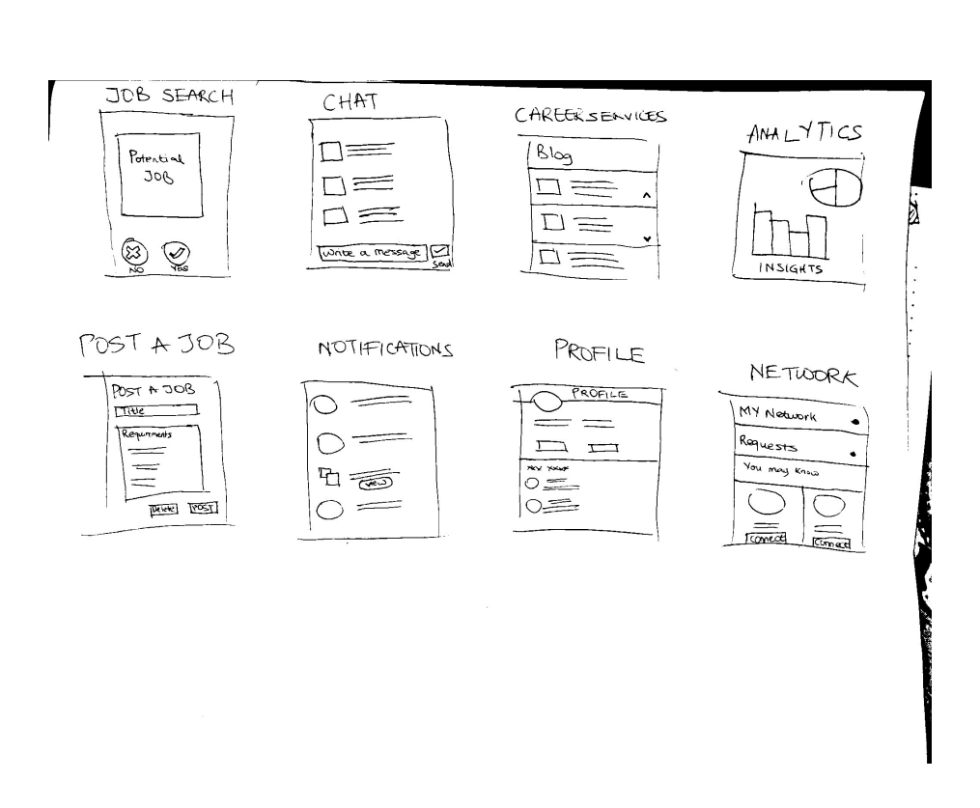
8 Sketches
Photo of your 8 sketches here

Slide 18
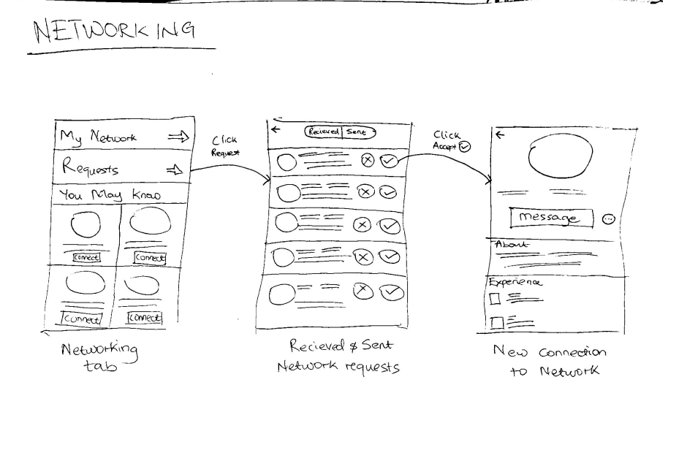
Solution Sketch 1
Upload a photo of your sketch on this slide

Slide 19
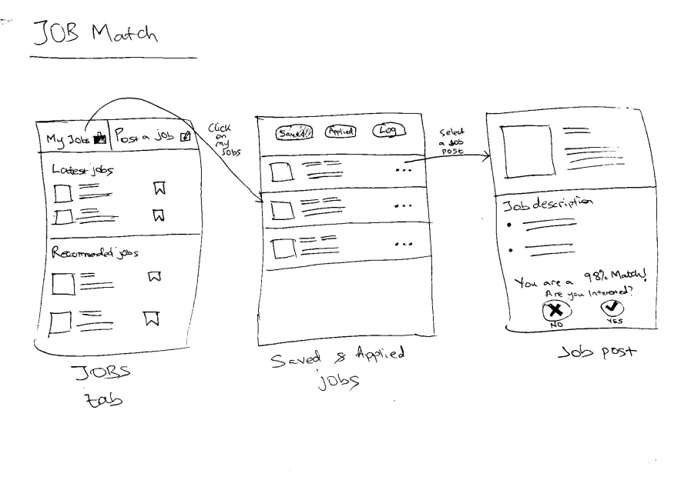
Solution Sketch 2
Upload a photo of your sketch on this slide

Slide 20
Decide
Pick the final concept that you develop into a prototype
Notes:
[ALL PARTICIPATION]

Slide 21
Decision
Decision | I have decided to incoporate the 2 solution sketches into my prototype
Rationale | I think that these are very important aspects of the GradMatch application due to the importance of the features to the success of the app

Slide 22
Prototype
Turn your concept into a realistic, interactive prototype that you will use to validate your assumptions and ideas
Notes:
[ALL PARTICIPATION]

Slide 23
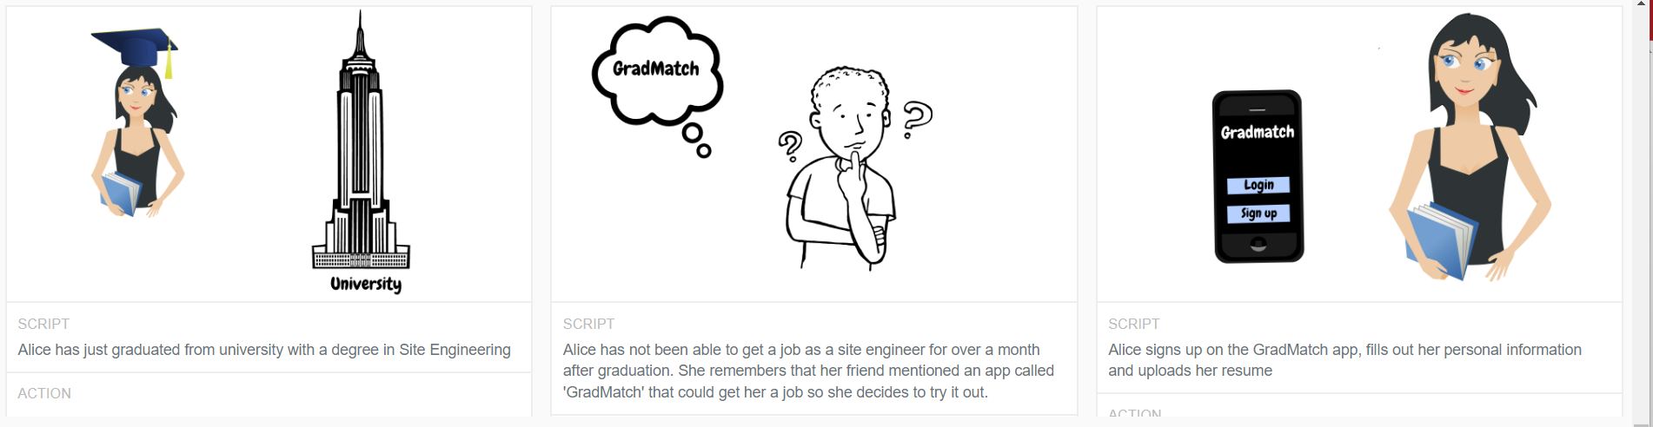
Storyboard
Script | Script | Script

Slide 24
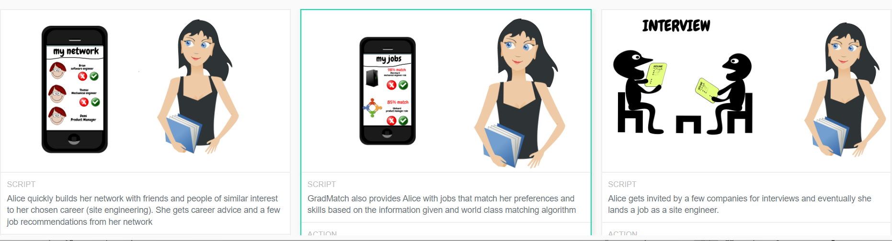
Storyboard
Script | Script | Script

Slide 25
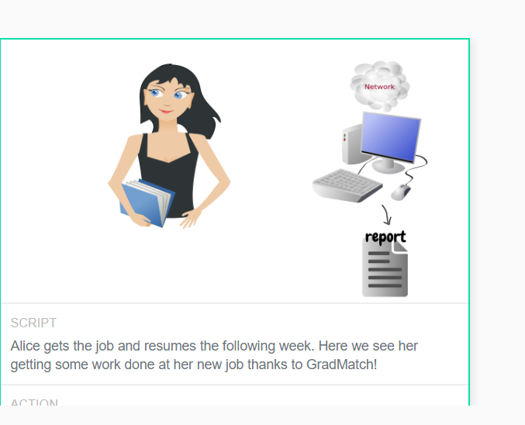
Storyboard contd.

Slide 26
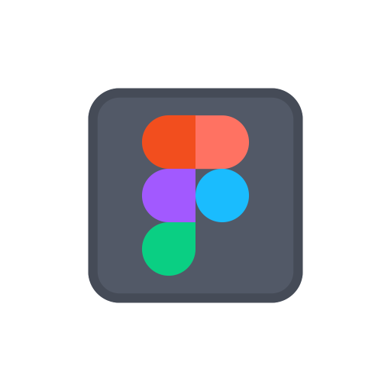
Prototype
Description High level overview of the prototype What does it do? | GradMatch app where users can sign in , network with connections as well as apply for jobs with a unique matching algorithm score based on profile
Assumptions Any assumptions within the prototype | User has already signed up and inputted all relevant information( background info, school experience, work experience, skills etc)
Tasks What are the tasks that a user can complete in the prototype? | User can log in User can access home , my network, profile, jobs, notifications tab user can apply for job (mid-level ux designer)
https://www.figma.com/file/iGXVhzPscLZiMtCrhOzM0W/GradMatch?node-id=0%3A1&t=GyIiKODFksfsXERi-1

Slide 27
Validate
Users will go through your prototype and provide feedback on your concept. This is also an opportunity to have an engineering feasibility discussion
Notes:
[ALL PARTICIPATION]

Slide 28
GradMatch: Research Plan
PM: Awoyomi Oluwademilade
STATUS: DRAFT
Objectives
The key research questions that the research plan aims to answer are:
How long it takes recent college graduates to get a job?
What are the main pain points that recent college graduates experience during the job search process?
What are the most important factors that recent college graduates consider when searching for job opportunities?
What are the most effective ways to provide personalized job recommendations to recent college graduates?
How can GradMatch differentiate itself from other job search platforms in the market?
Methodology
Surveys: Conduct online surveys to gather quantitative data on the job search behaviors, preferences, and pain points of recent college graduates.
User interviews: Conduct in-depth interviews with recent college graduates to gain qualitative insights into their job search experiences, needs, and pain points.
Focus groups: Organize focus groups with recent college graduates to gather more detailed feedback on the app's user interface, features, and overall user experience.
Competitive analysis: Conduct a competitive analysis of other job search platforms in the market to identify best practices, gaps in the market, and areas where GradMatch can differentiate itself.
Participants
We want the main participants to be recent college graduates. Specifically these people should have graduated within the past year or have about 6 months left to graduate

Slide 29
GradMatch: Interview Sessions
Introduction
My Name is Demi and I’m a product manager at LinkedIn. The team has been working on some exciting new ideas about matching recent college graduates to jobs based on their skill and preference and we wanted to share them with you and get your feedback.
The way the interview will run is I have a few background questions to get to know you a little better and your experience with job search/finding apps. Then we will switch it up a bit and I will show you a prototype the team and I have been working on and I want to get your honest feedback
Before we begin, kindly review and sign this Non Disclosure Agreement form. I hope its okay if I record this session, the recording is only going to be used internally by the team to refer back to our conversation and the points you have made.
Background Questions
Tell me a bit about yourself(Name, job title, University attended and course taken)
When did you graduate? How long did It take you to find a job after graduation
How did you get your current job and is it related to your course/skills and preferences?
Background Questions related to job matching apps
Are you familiar with job finding applications? Have you used any? Why or why not?
Have you gotten any job from any job fining apps? If yes, How easy was the process?
Do you think the job alerts are specifically curated to you?
Pain points of job matching apps?
Prototype
Now I'm going to show you a prototype the team has been working on. Please note , not everything may work just the main features. Disclaimer: YOU ARE NOT BEING TESTED! We just want your feedback on what we've built. Please feel free to think out loud

Slide 30
GradMatch: Interview Sessions
Task
Go ahead and login. We’re assuming you’ve signed up and inputted all relevant info (background info, schooling, work experience, skills, job preferences). Can you describe what you see?
Task 1
Lets say you wanted to apply for a job. How would you go about that?
Task 2
Lets say you wanted to follow someone and make a new connection. Walk me through your process of achieving that
Wrap Up
Thanks for that! Rounding up now, I have a few questions.
Do you think this app is something you would use and recommend to friends? Why or why not?
Are there any drawbacks or improvements or additional features you would like to see?
What do you think differentiates us from the regular job matching app?
Thanks for coming in! We really appreciate you taking out time out of your busy schedule to share your thoughts and provide feedback. It is very much appreciated. Cheers.

Slide 31

User Testing: Participant 1 Key Findings
Link your audio recording
What worked well | Participant 1 was able to navigate through the app very well with no issues. He was able to carry out tasjs successfully without any hassle.
Where participants got stuck | How to add a new connection was a bit rough but he got it in the end
Other observations | This participant really liked the interface of the app and the fact that it was easy to use.

Slide 32
Participant 1: Interview Notes
Easily navigated through the app without any issues
Made a case for the chat feature to be more visible and accessible
Good UI/UX and theme
The matching score on each job based on profile details was very informative and gave increased confidence

Slide 33
User Testing: Participant 2 Key Findings
Link your audio recording
What worked well | This participant logged in successfully and was able to navigate through the application seamlessly. He was able to carry out all tasks
Where participants got stuck | No issues
Other observations | none

Slide 34
Participant 2: Interview Notes
The matching score on each job based on profile details was very informative and made this participate very excited. In his opinion, it set us apart from counterpatts
Good UI/UX, easy to use and navigate through features
No additional features, satisfied.

Slide 35
Handoff
© 2019 Udacity. All rights reserved.
Notes:
[ALL PARTICIPATION]

Slide 36
Updated PRD
Background:
The job market for recent college graduates can be highly competitive, with many graduates struggling to find job opportunities that align with their skills and preferences. According to a report by the Economic Policy Institute, the unemployment rate for recent college graduates in the United States was 7.7% in 2020. This highlights the need for innovative solutions that can help recent college graduates find job opportunities that align with their skills and preferences.
Problem:
The GradMatch app aims to solve the problem of recent college graduates struggling to find job opportunities that align with their skills
and preferences. The app provides personalized job recommendations to users based on their skills, experience, and preferences.
Key insights driving this problem include:
Recent college graduates often struggle to find job opportunities that align with their skills and preferences.
Existing job search platforms often provide generic job recommendations that do not take into account the unique skills and preferences of individual users.
Personalized job recommendations can increase the likelihood of recent college graduates finding job opportunities that align with their skills and preferences.
Competitors in the job search market include platforms such as LinkedIn, Indeed, and Glassdoor. These platforms offer job search functionality, but do not offer the level of personalization that the GradMatch app aims to provide.
This matters because recent college graduates are a key demographic in the job market, and are in need of innovative solutions to help them find job opportunities that align with their skills and preferences. The GradMatch app has the potential to fill this gap in the market and provide a valuable service to recent college graduates.

Slide 37
Updated PRD (page 2)
Goals:
The goal of the GradMatch app is to provide recent college graduates with personalized job recommendations that align with their skills and preferences. Success for the app looks like:
High user engagement and retention rates.
Positive user feedback on the app's user interface, features, and overall user experience.
Increased job placements for recent college graduates through the app.
Features:
The features of the GradMatch app will be prioritized as follows:
P0: Skill and preference assessment: Users will be prompted to complete a series of questions that assess their skills, experience, and preferences. This information will be used to provide personalized job recommendations.
P0: Connections and Networking (: The app will allow users to connect with alumni and other professionals in their industry, expanding their network and increasing their job opportunities.
P0: Job search functionality: Users will be able to search for job opportunities based on location, job title, and keywords.
P1: Personalized job recommendations: Based on the user's skill and preference assessment, the app will provide personalized job recommendations that match the user's profile.
P1: Company research: Users will be able to research potential employers and view information on company culture, benefits, and employee reviews.
P2: Resume and cover letter builder: Users will be able to create professional resumes and cover letters through the app.

Slide 38
Sources
National Association of Colleges and Employers. (2021). Class of 2021 Student Survey Report. Retrieved from https://www.naceweb.org/globalassets/documents/2021-student-survey/winter-2021-student-survey-report.pdf
LinkedIn. (2019). Global Talent Trends 2019. Retrieved from https://business.linkedin.com/content/dam/me/business/en-us/talent-solutions/resources/pdfs/linkedin-global-talent-trends-2019.pdf
According to a survey conducted by Accenture, 80% of college students believe their college or university is not doing enough to prepare them for the workforce. (Source: https://www.cnbc.com/2019/04/30/college-graduates-are-worried-theyre-not-prepared-for-the-workforce.html)
The job market is becoming increasingly competitive, with an average of 250 resumes received per corporate job opening. (Source: https://www.glassdoor.com/blog/whats-the-real-reason-why-hr-people-dont-give-feedback-after-job-interviews/)
Networking is a key factor in job search success, with 70% of jobs filled through networking. (Source: https://www.businessinsider.com/how-to-network-to-get-a-job-2016-4)
Economic Policy Institute. (2021). The Class of 2020. Retrieved from https://www.epi.org/publication/the-class-of-2020/.
LinkedIn. (2021). About Us. Retrieved from https://about.linkedin.com/.

